Slide 1

Notes:
Hi my name is Jeremy Johnson with Nashville Software School’s Data Analytics Bootcamp DDA13

Slide 2
Inspiration
As weekend golfer I try to stay postive when I’m playing 18 holes because I know golf is hard. Golf tests your patience, requires phyiscal precision and all while battling the outdoor elements. I have noticed my fellow golfers tend to have too high of expectations for their rounds leaving them frustrated. This made me want to look into the skill level gap between the pros and amateurs.
It is not beneficial to compare your golf game to the professionals you see on TV. The PGA Tour players are extremely skilled and are paid extremely well to play golf for a living. Amateurs would benefit from knowing when they have hit a shot or made a putt around the tour average with the pros and in turn have more fun golfing.
Quick overview of golf terminology
Why are pros scores lower than amateurs?
A look into the difficulty of the courses played on the PGA Tour
The aspects of the pros games that the amateurs can compete with.
How much further do the pros drive the ball?
Why amateurs should lower expecations to have more fun.

Slide 3

OBJECTIVES
INTRO
SCORING
Quick overview of golf handicaps
Why are pros scores lower than amateurs?
COURSES
A look into the difficulty of the courses played on the PGA Tour
GET IT CLOSE
The aspects of the pros games that the amateurs can compete with.
OFF THE TEE
CONCLUSIONS
How much further do the pros drive the ball?
Why amateurs should lower expecations to have more fun.
Notes:
This presentation is going to cover a quick intro into golf handicaps followed by a look into the difficulty of golf courses played on tour. We are going to cover some stats of the pros like driving distance and scoring comparisons between pros and amateurs. We will also look into some putting differences and where amateurs should be practicing to shoot lower scores.

Slide 4

Golf Handicap
A golf handicap is a number that levels the playing field between golfers of different skill levels. It adjusts your score based on your ability, so players can compete more fairly. A lower handicap means a better golfer.
Low handicap: 0(also called “scratch”)–10
Mid-Handicap: 11–18
High handicap: 19+
A 54 is considered the maximum handicap. This would be your handicap if you had never played golf and decided to get out for 18 holes today.
Notes:
Golf handicaps were created to help golfers of different skill levels compete fairly against each other. The lower the handicap the better the golfer.
For comparison PGA golfers do not have handicaps listed as they do not give up any strokes for tournament play. However, if their handicaps were recorded the average PGA golfer would be a +5.4. Meaning they would have to have scores at least be 5 strokes under par to level the playing field with amateurs.

Slide 5

PGA COURSES
Golf courses are rated by two systems. Course rating is based on what a 0 ("scratch“) handicap player would score. While the Slope measures the difficulty between an 18-handicap golfer and a scratch golfer. Slopes measurements are between 55 and 155. The average slope is a 113.
Most golf courses that amateurs play average between 4,952 yards and 6,518 yards pending the tee boxes being played from.
Courses played on the PGA Tour average 7,221 yards with an average Slope Rating at 148.8 and average course rating of 75.
BELOW ARE 5 OF THE TOUGHEST COURSES PLAYED ON THE PGA TOUR
Oak Hill East (Pittsford,New York) Par 70 Course Rating 77.3 Slope 153
The Los Angeles Country Club – North Course Par 70 Course Rating 75.7 Slope 143
Torrey Pines - South Course(San Diego, CA) Par 71 Course Rating 78.8 Slope 148
Royal Liverpool Golf Club (Wirral, England) Par 71 Course Rating 77.1 Slope 152
Augusta National (Augusta, Georgia) Par 72 Course Rating 76.2 Slope 148
Notes:
Golf courses basically have two rating systems to judge how difficult they are. Course Rating is based on what a 0 (scratch) handicap would score. While the Slope is determined by comparing that scratch golfer and an 18 handicap golfer to configure a slope rating. One of the biggest differences in the PGA Tour courses and the average courses that amateurs play is the yardage of a course. Amateur course average around 5,000 to 6,500 yards while the PGA courses average closer to 7,200 yards. This yardage difference certainly influences the course and slope rating. That is why PGA courses have much high slope and course ratings.

Slide 6
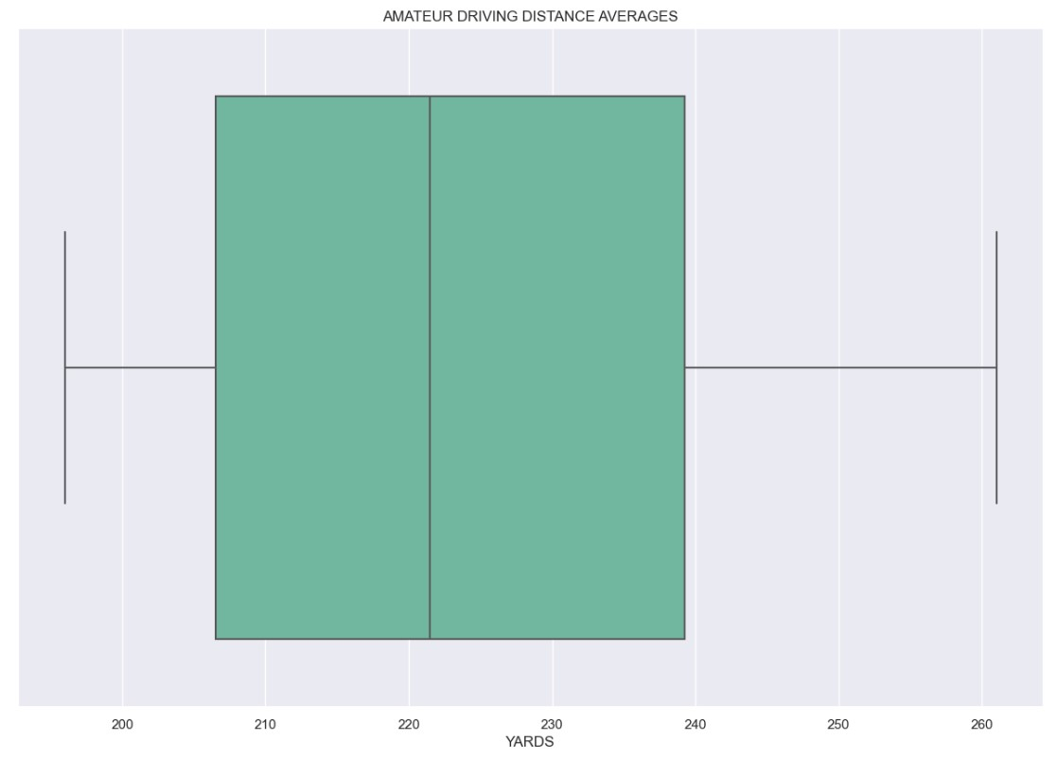
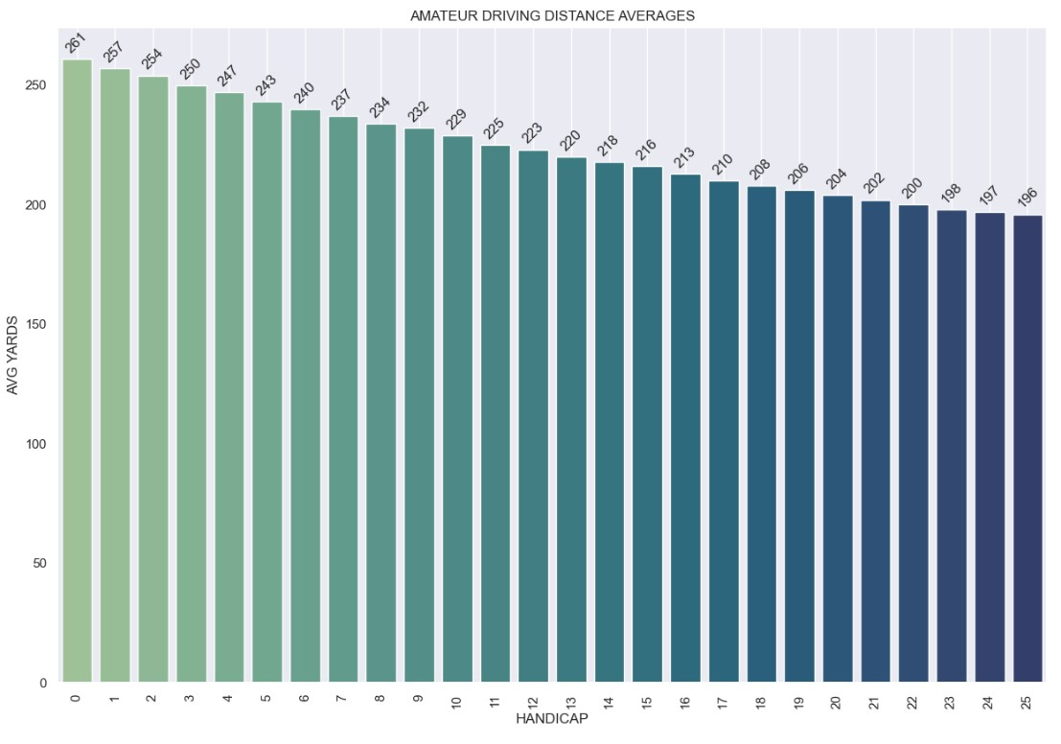
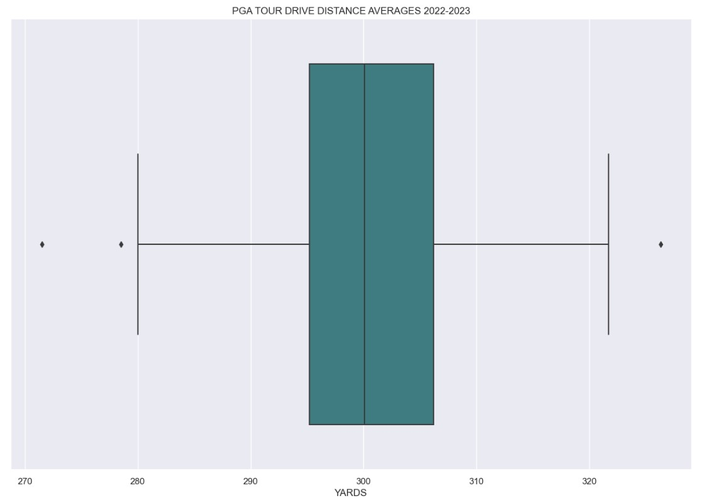


Slide 7
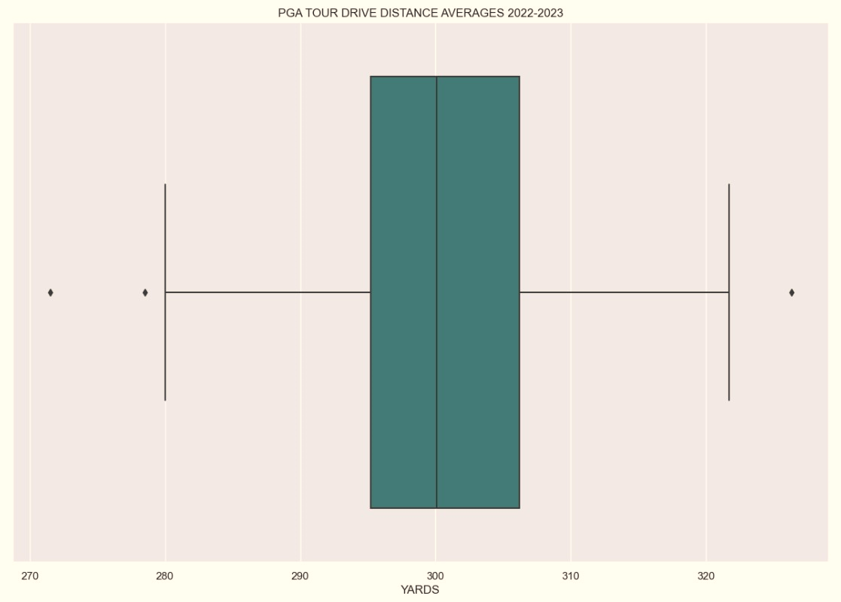
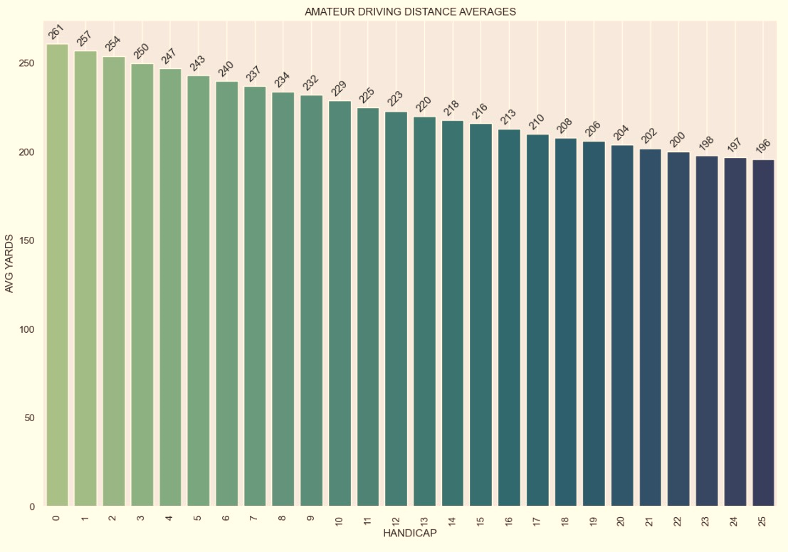
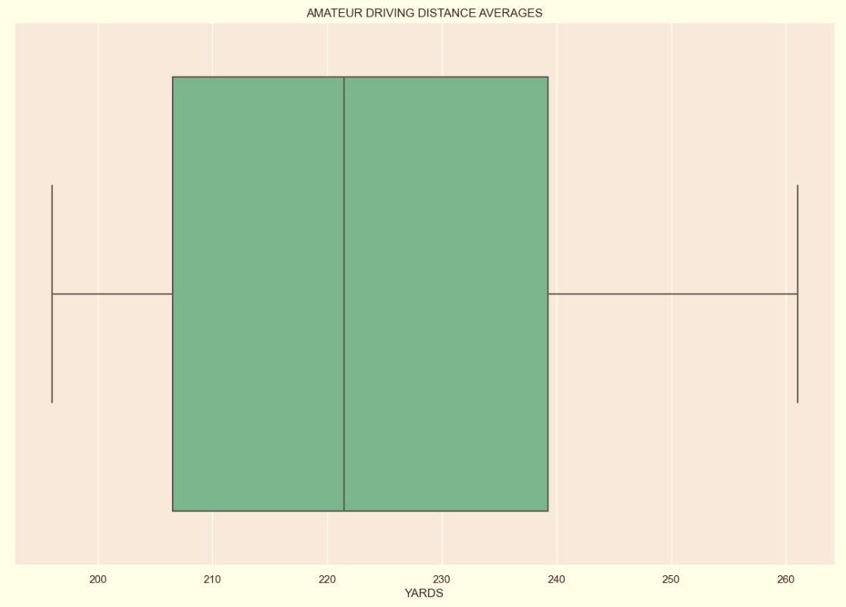
DRIVING DISTANCE
When it comes to driving the golf ball it is easy to see why PGA Tour players get paid to play golf while hobbyist golfers pay to play.
PGA Tour players average about 300 yards from the tee box.
While the average drives for the weekend golfer, across all handicaps, is closer to 225 yards

Slide 8
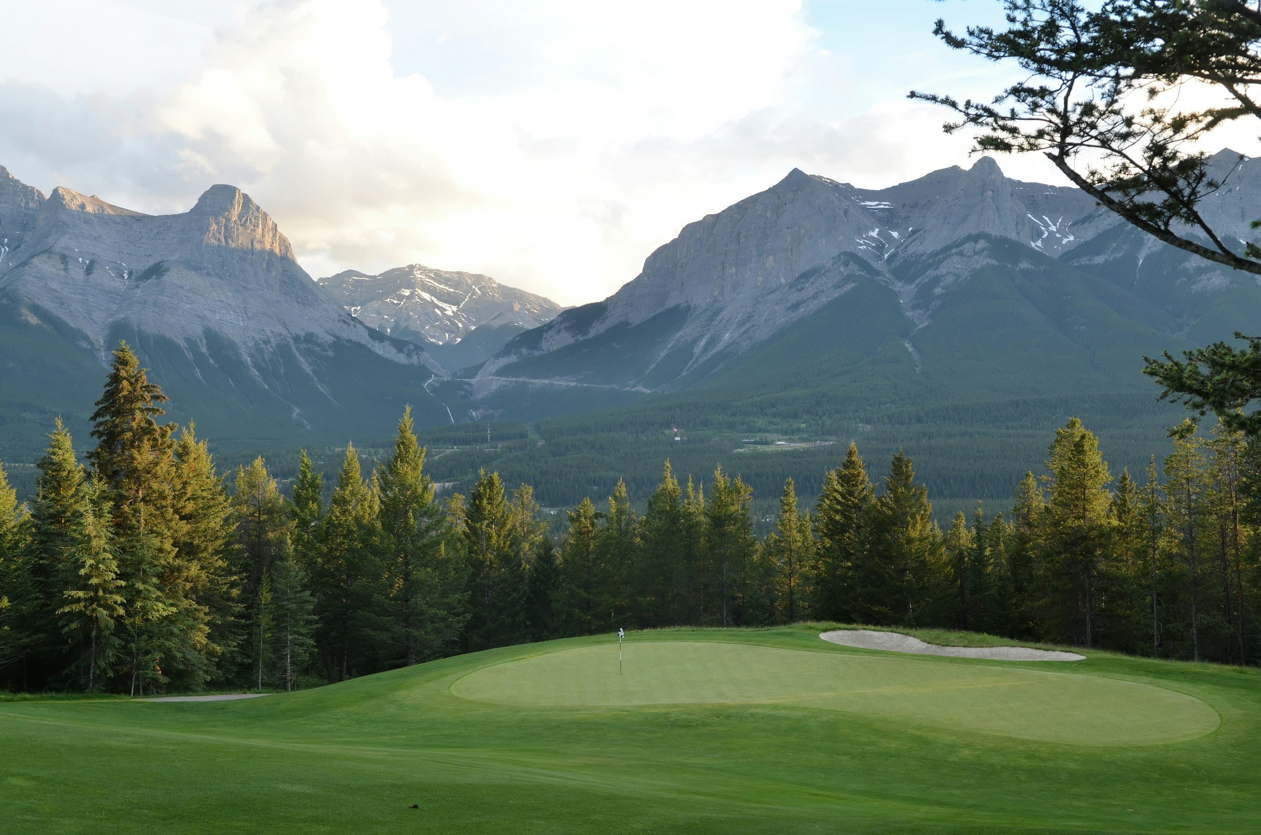
PAR FOR THE COURSE
On a standard par 72 golf course that consists of 18 holes, the average distribution of par 3s, par 4s, and par 5s is typically :
Par 3s (shortest holes): 4 holes
Par 4s (intermediate holes): 10 holes
Par 5s (longest holes): 4 holes

Slide 10
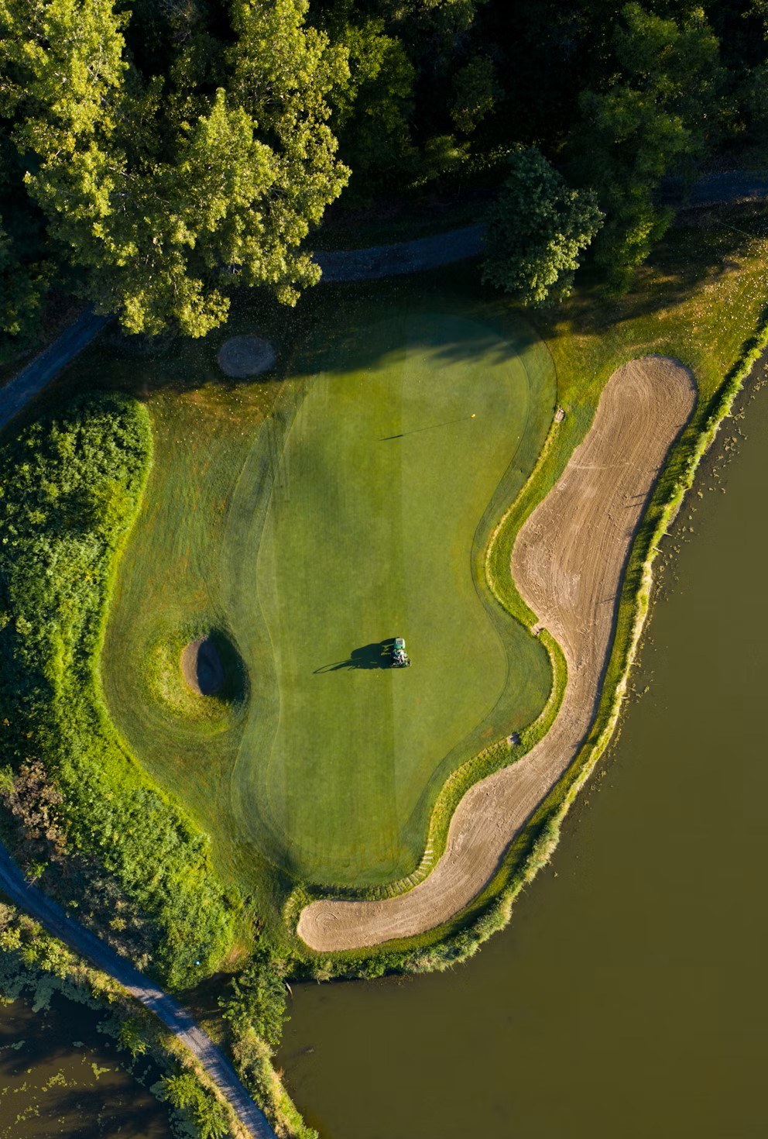
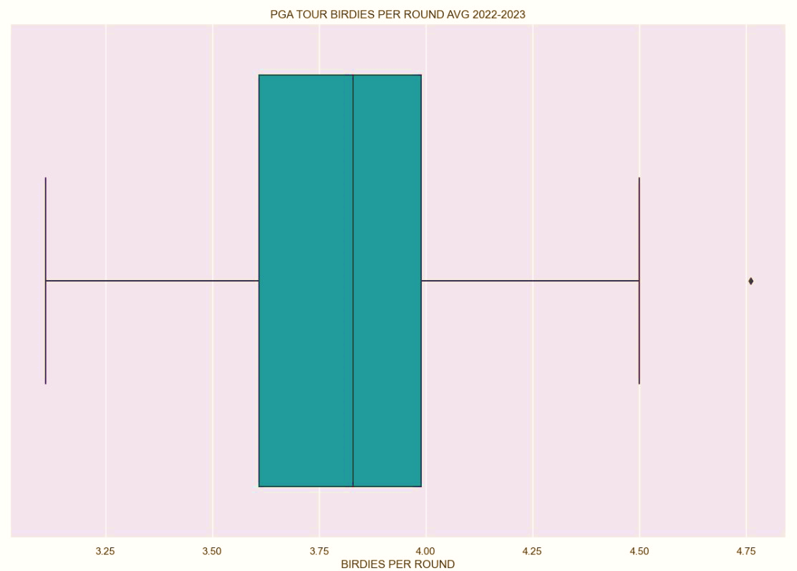
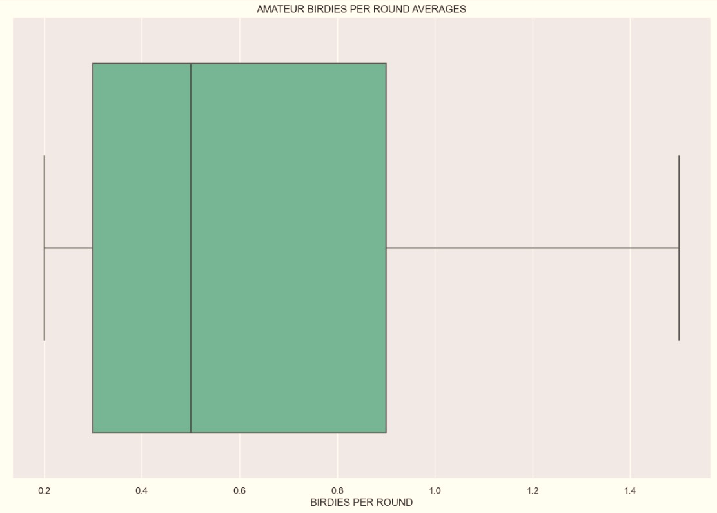
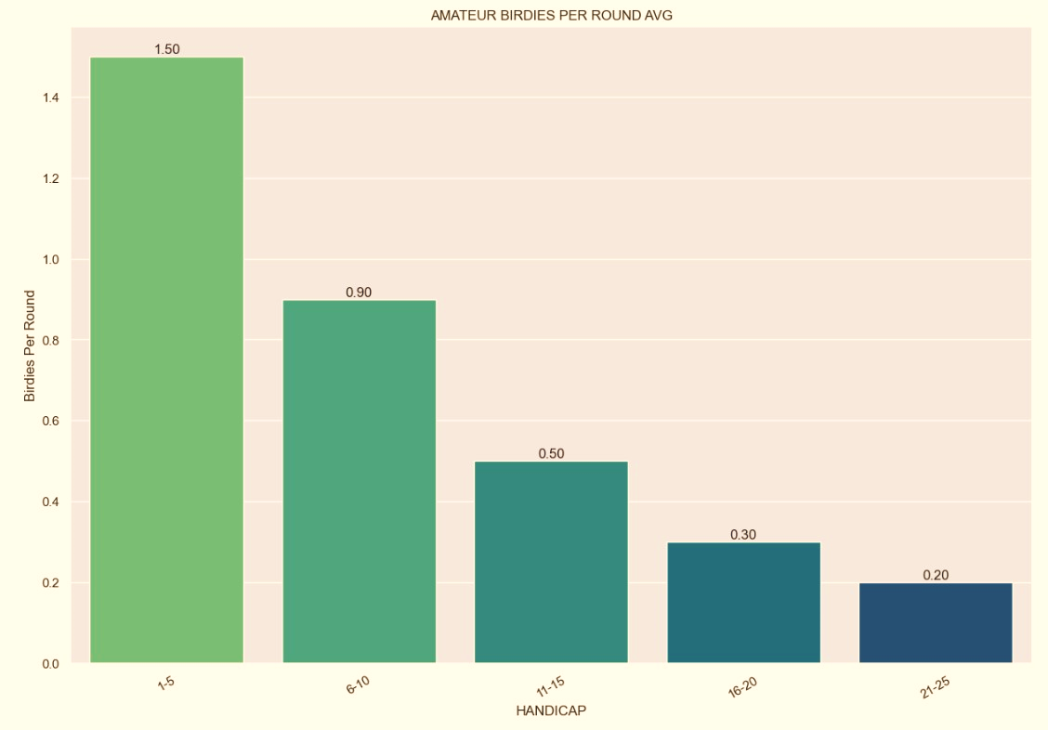
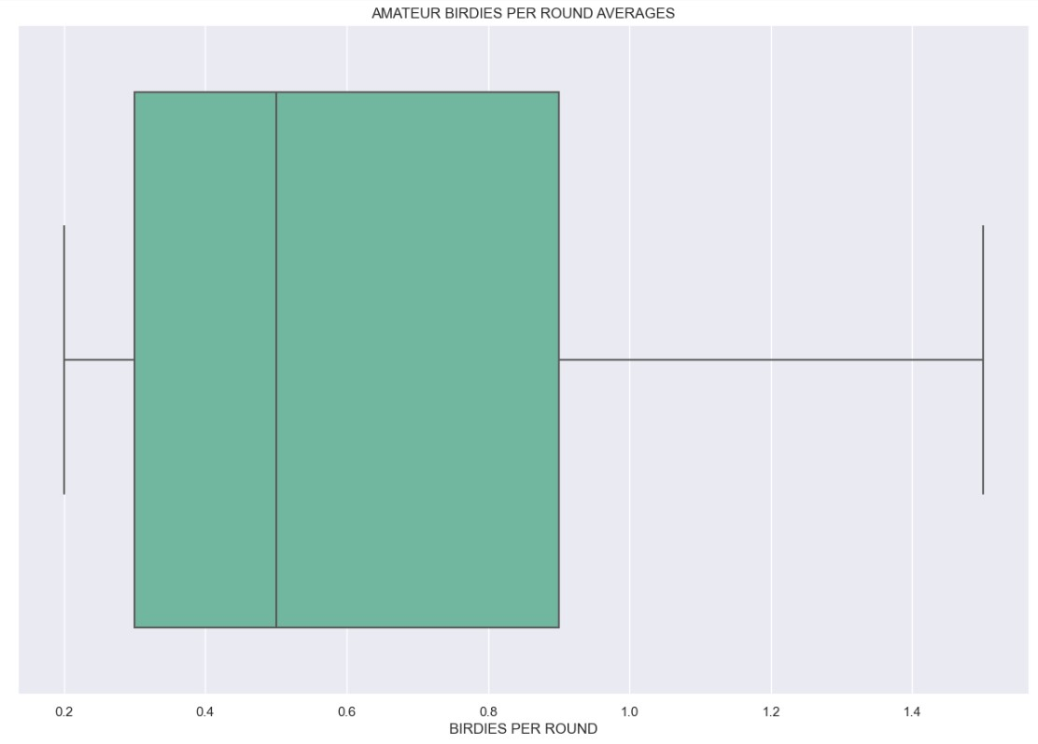

TWEET TWEET
A “birdie” is when a player finishes the hole one stroke under the par for the hole.
Tour players average almost 4 birdies in a round. Helping their scores be under par for the course or better by several strokes.
Even the lowest handicap amateur golfers average less than half the birdies per round compared the professionals.

Slide 11
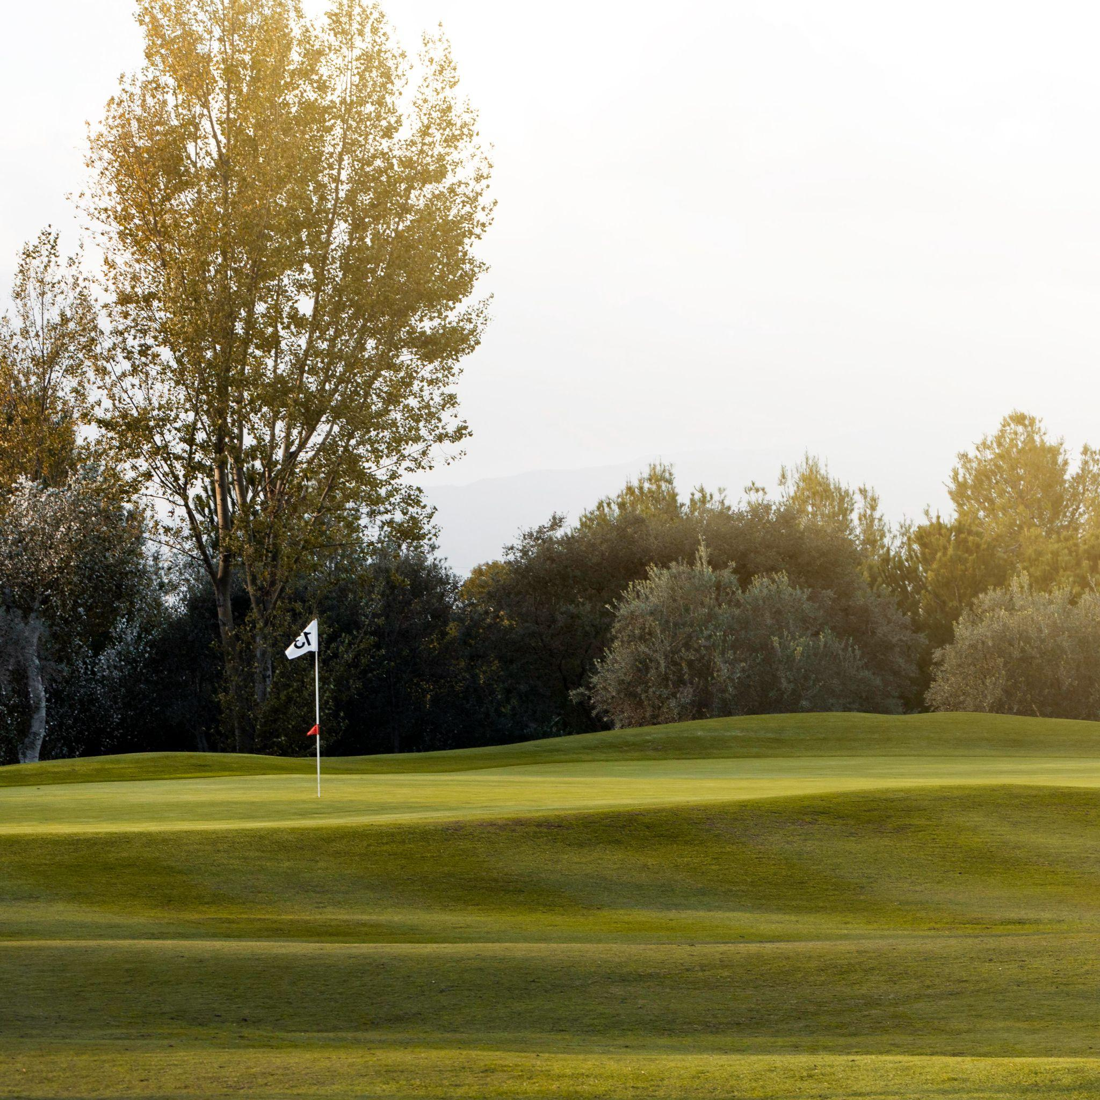
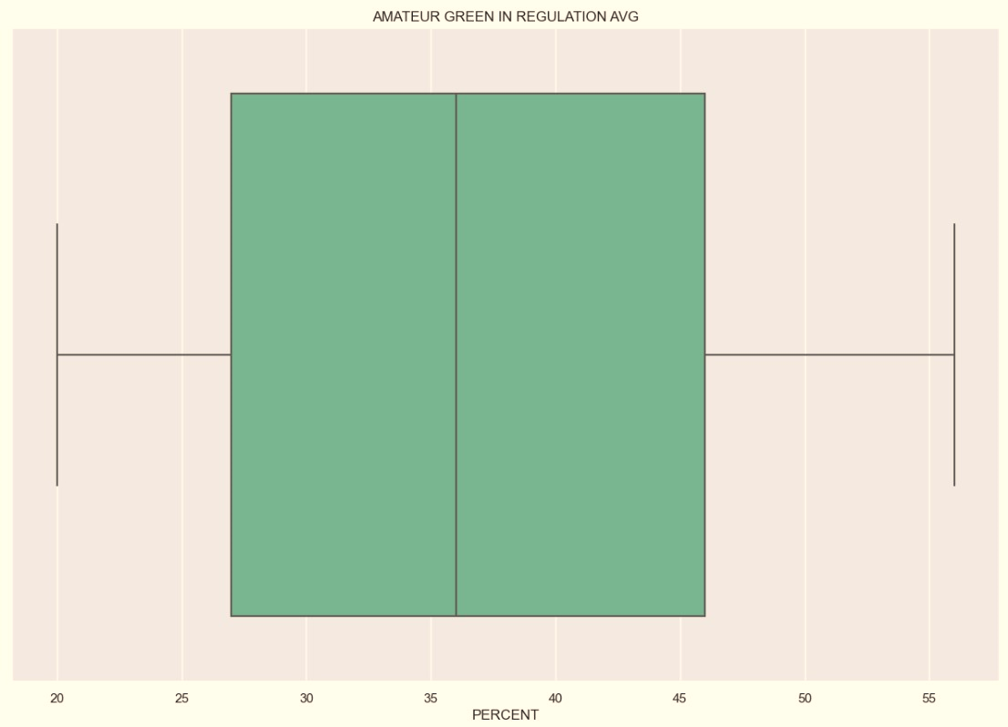
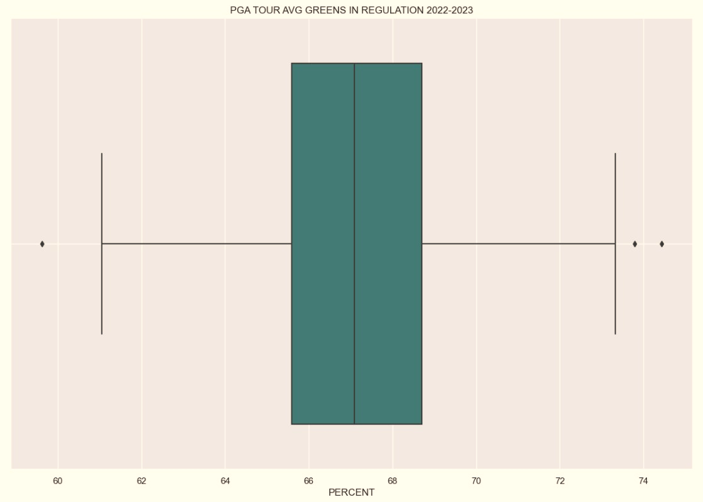
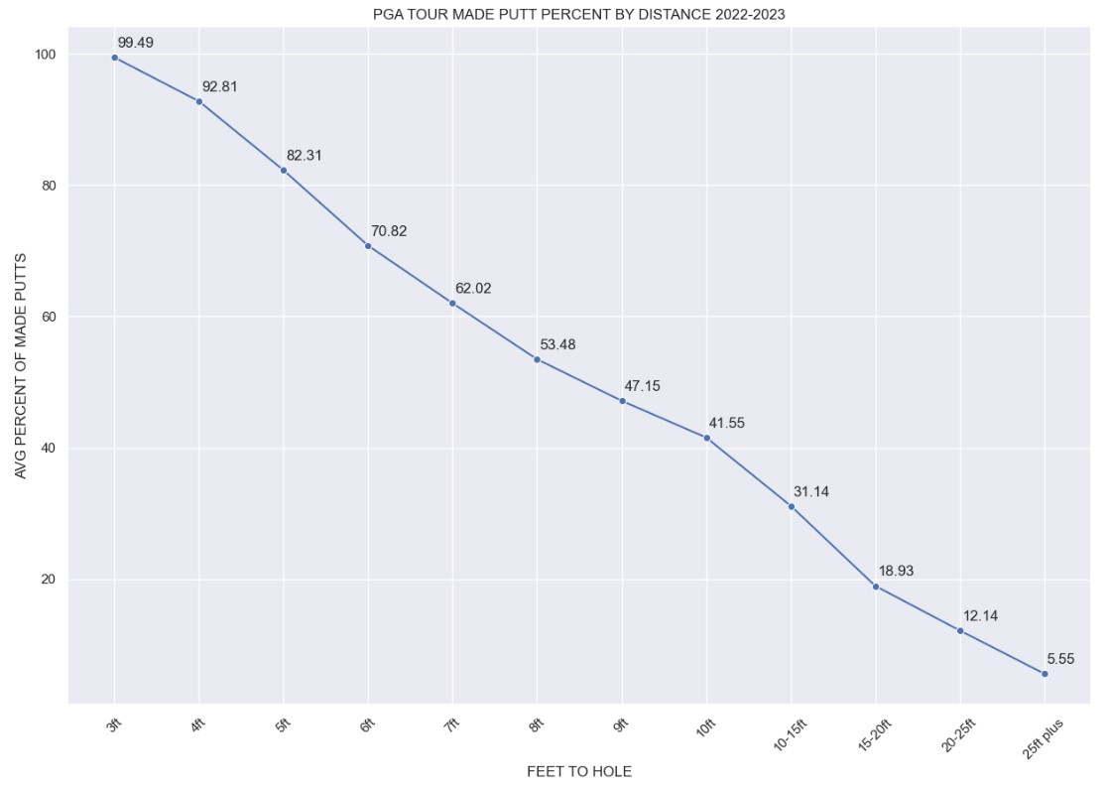
GIR
Every foot back from 3 feet the pro average drops roughly 8.51%.
They go from nearly 100% from 3 feet away to almost 50% from 8 feet away.
Amateurs should be thrilled to sink putts from 8 feet away instead of expecting them to go in the hole.
YOU ARE NOT GOING TO MAKE ALL THE PUTTS
Green in Regulation: The number of strokes to arrive on the putting surface with your ball, this should equate to two shots below the par for any given hole.
Notes:
This is to say on Par 3s you should reach the green in one shot and have two putts to make par. Par 4s you should reach in 2 shots and have 2 putts for par and Par 5s should be reached in 3 shots with 2 putts for par.

Slide 12
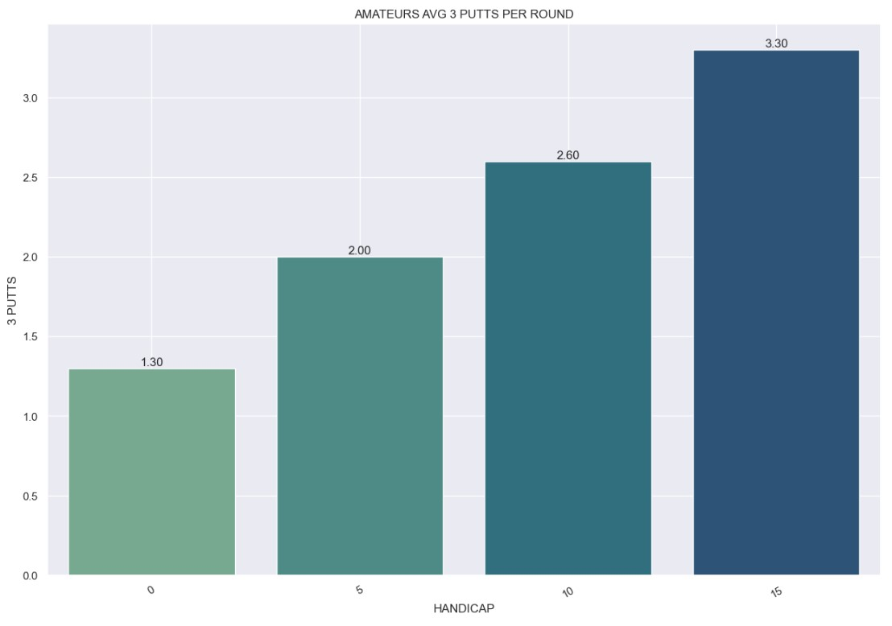
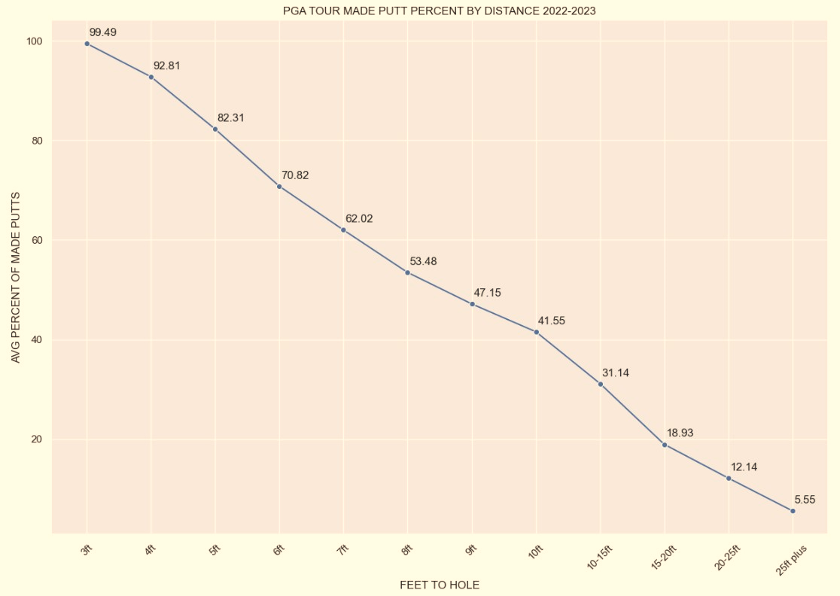
DRIVE FOR SHOW, PUTT FOR DOUGH
AMATEUR PUTTS PER ROUND AVG
YOU ARE NOT GOING TO MAKE ALL THE PUTTS
34.2
Every foot back from 3 feet the pro average drops roughly 8.51%.
Pros are nearly 100% from 3 feet away to almost 50% from 8 feet away.
Amateurs should be thrilled to sink putts from 8 feet away instead of expecting every putt to go in the hole.
PGA TOUR PUTTS PER ROUND AVG
28.96
Notes:
The putting stats are what really started to stand out to me during this analysis. The PGA Tour average on making putts from 3ft is nearly 100% and if they back up to 8ft they are closer to 50%. This is where amateurs should be thrilled to make these long putts, knowing they performed better than about half of the golfers on tour.

Slide 13
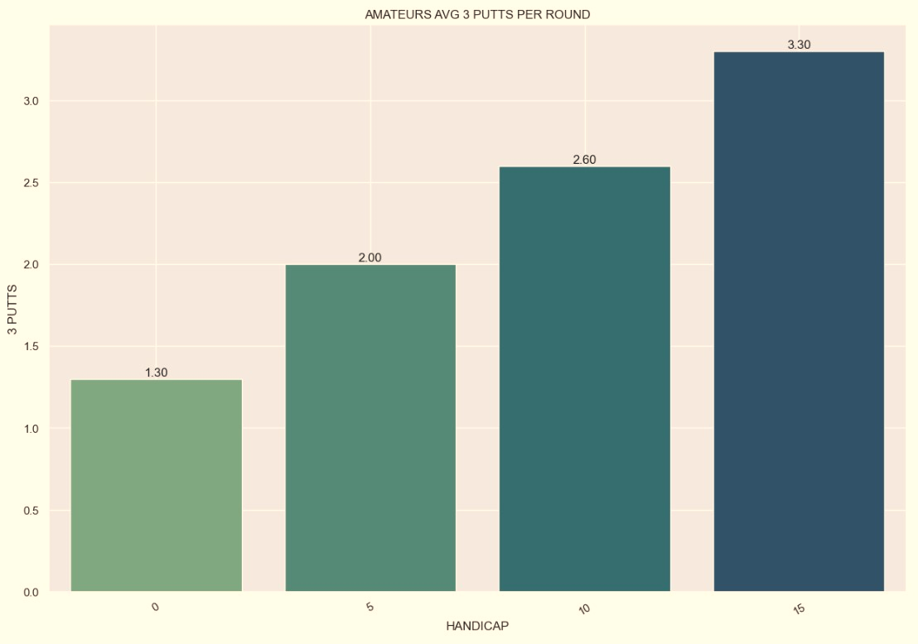
DRIVE FOR SHOW, PUTT FOR DOUGH
Outer circle
Include the total size of the market, which represents the entire potential customer base for the product or service
Putting is important in golf because it can account for up to 43% of a golfer's total strokes, regardless of skill level.
Middle circle
AMATEUR PUTTS PER ROUND AVG
34.2
Inner circle
PGA TOUR PUTTS PER ROUND AVG
Indicate the current market size, which represents the portion of the target market that the company has successfully captured
28.96
If an amateur reaches the green in regulation, they are much more likely to putt the ball three times just to get the ball in the hole.
For PGA Tour players the average 0.48 3 putts per round. The highest average for any one player is 0.83.
Notes:
Putting is a major factor to scoring in golf. The skill of short shots can outweigh the advantage of hitting the ball a long way. Out of 18 holes pros average 1.5 putts a hole. Meanwhile most amateurs are closer to 2 putts. Also, pros RARELY if ever take 3 putts on a green. Whereas amateur can average 1- 3 three putts per round. These extra strokes add up on the scorecard.

Slide 14
DISTANCE TO PIN COMPARISONS
Where I believe amateurs get most frustrated is not understanding when they have hit a good shot onto the green. Understanding that most tour players do not hit the ball within inches of the hole every time would help amateurs set better expectations for their rounds.
Amateurs are bound to hit shots within the tour average or better from time to time. These are shots to celebrate, not to get mad they did not go in the hole.
Notes:
When you watch the PGA Tour they will always show the highlights of the best shots. This is where amateurs need to look to the data and not what they see on TV. Not every shot ends up right next to the hole. Amateurs could benefit from knowing they hit shots as good or better than the tour average.

Slide 15
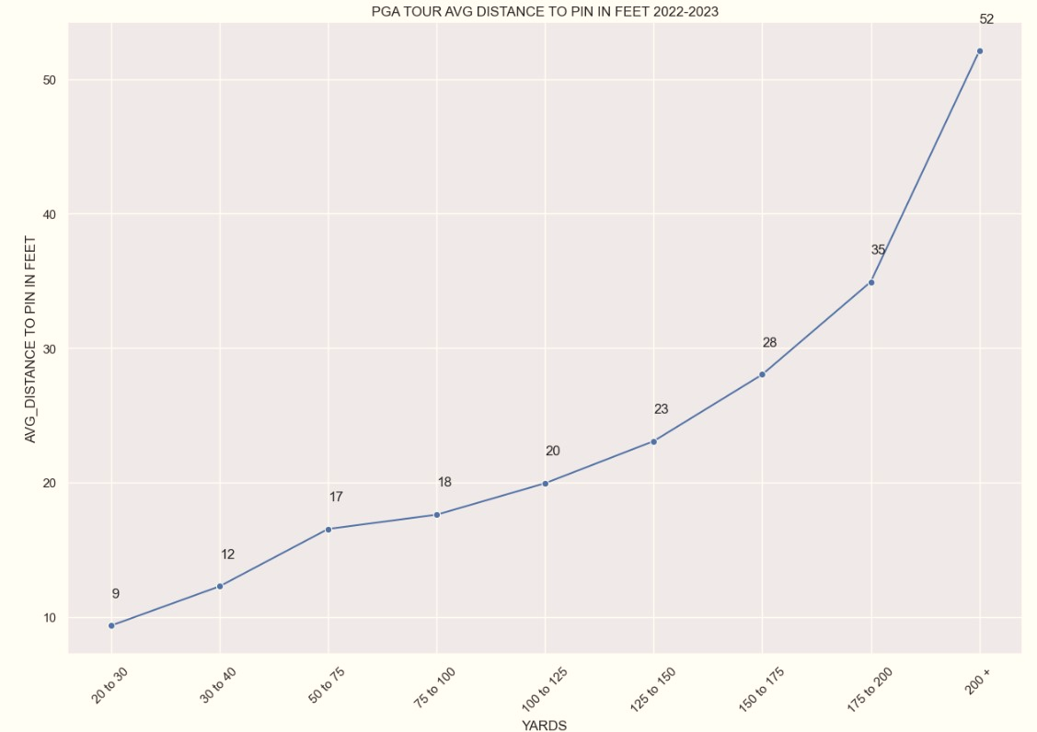
THE PROS ARE NOT ALWAYS THAT CLOSE
Notes:
This graph is looking at the distance to the pin (in feet) the pros are from different yardages out. You can see the further out they are the further they end up from the pin. Remember those putting stats? A pro may hit the ball to 9 ft of the cup but they average 47% made putts from that distance.

Slide 16
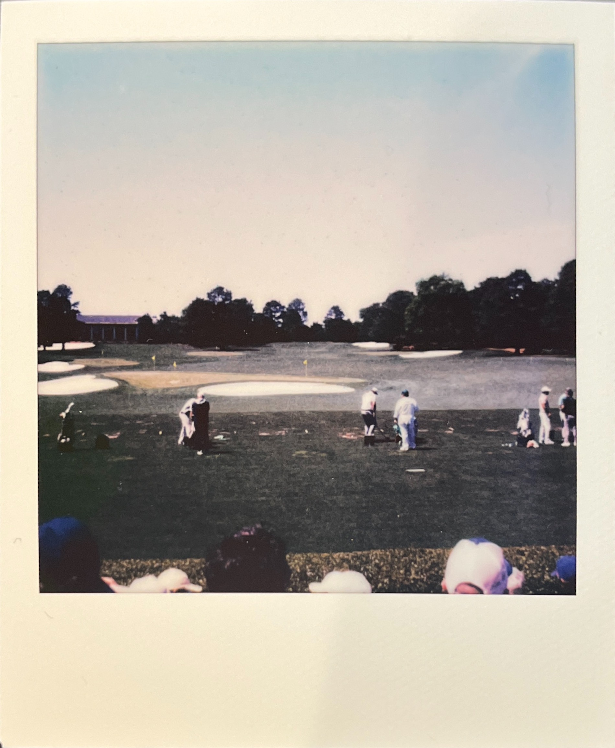
PGA Tour Players have an average standard deviation of 3 ft across the distances compared. Meaning from the player that averages the furthest from the pin on approach shots is still within 3 feet of the best player from that yardage.
Whereas the average standard deviation of handicaps 0-25 is closer 15 feet apart. This shows an obviously bigger gap between the best amateurs and the ones that need a little more practice.
Notes:
Looking at the tour averages of distances to the pin we see that the gap between the best players on tour and bottom tier players on tour is about a 3ft deviation. Meanwhile the gap between the best amateur golfers and higher handicap players is closer to a 15 foot deviation.

Slide 17

IN CONCLUSION
The PGA Tour pros play incredibly harder courses than the average amateur.
Amateurs should not try to compare stats with what the pros do in their rounds.
Amateur golfers will rarely, if ever, be able to hit the golf ball as far and as consistent as pro golfers.
However, if the amateurs would focus on improving their putting, they would see great improvements on their 18-hole scores.
The amateurs should not be disappointed their shots are not always inches away from the hole. They would benefit from knowing they hit some tour level shots in their round.
This would lead to less frustration on the course and be able to have more fun on their weekend rounds of golf!

Slide 18
IN CONCLUSION
The PGA Tour pros play incredibly harder courses than the average amateur.
Amateurs should not try to compare stats with what the pros do in their rounds.
Amateur golfers will rarely, if ever, be able to hit the golf ball as far and as consistent as pro golfers.
However, if the amateurs would focus on improving their putting, they would see great improvements on their 18-hole scores.
The amateurs should not be disappointed their shots are not always inches away from the hole. They would benefit from knowing they hit some tour level shots in their round.
This would lead to less frustration on the course and be able to have more fun on their weekend rounds of golf!

Slide 19
IN CONCLUSION
The amateurs should not be disappointed their shots are not always inches away from the hole. They would benefit from knowing they hit some tour level shots in their round.
This would lead to less frustration on the course and be able to have more fun on their weekend rounds of golf!
The PGA Tour pros play incredibly harder courses than the average amateur.
Amateurs should not try to compare stats with what the pros do in their rounds.
Amateur golfers will rarely, if ever, be able to hit the golf ball as far and as consistent as pro golfers.
However, if the amateurs would focus on improving their putting, they would see great improvements on their 18-hole scores.

Slide 20
IN CONCLUSION
Amateur golfers will rarely, if ever, be able to hit the golf ball as far and as consistent as pro golfers.
However, if the amateurs would focus on improving their putting, they would see great improvements on their 18-hole scores.
The PGA Tour pros play incredibly harder courses than the average amateur.
Amateurs should not try to compare stats with what the pros do in their rounds.
The amateurs should not be disappointed their shots are not always inches away from the hole. They would benefit from knowing they hit some tour level shots in their round.
This would lead to less frustration on the course and be able to have more fun on their weekend rounds of golf!

Slide 21
IN CONCLUSION
The PGA Tour pros play incredibly harder courses than the average amateur.
Amateurs should not try to compare stats with what the pros do in their rounds.
The amateurs should not be disappointed their shots are not always inches away from the hole. They would benefit from knowing they hit some tour level shots in their round.
This would lead to less frustration on the course and be able to have more fun on their weekend rounds of golf!
Amateur golfers will rarely, if ever, be able to hit the golf ball as far and as consistent as pro golfers.
However, if the amateurs would focus on improving their putting, they would see great improvements on their 18-hole scores.

Slide 22
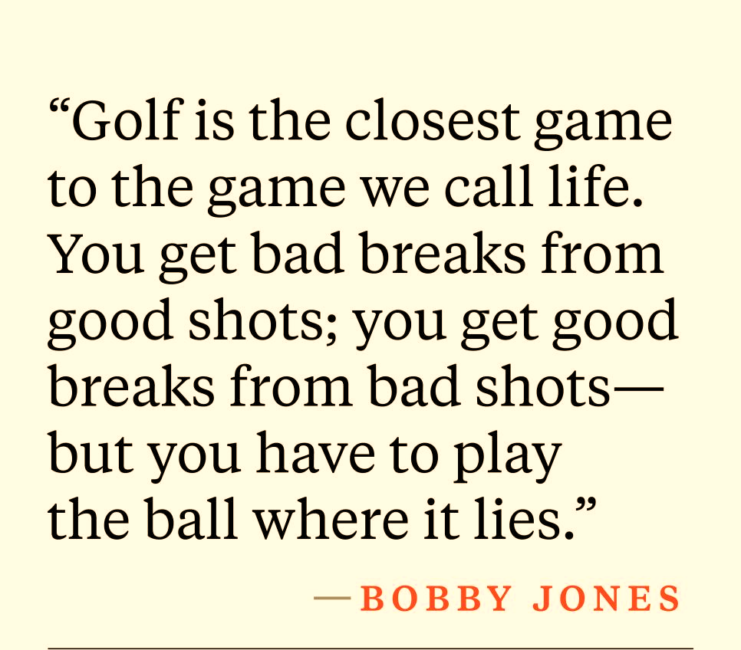
IN CONCLUSION

Slide 23
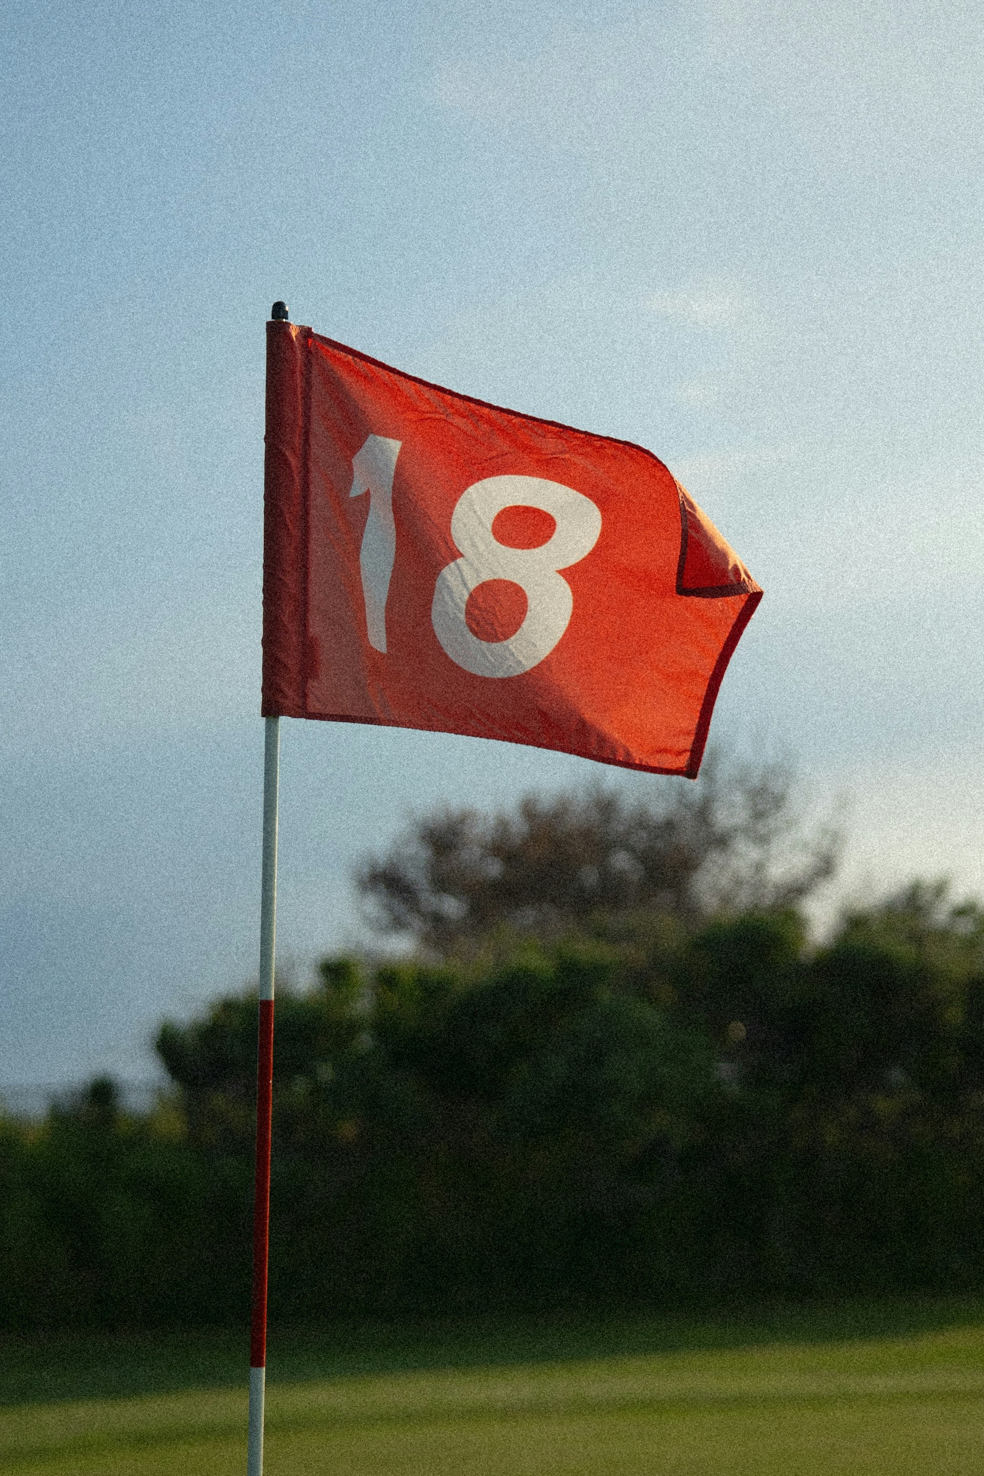
THANK YOU
DATA SOURCES
https://www.pgatour.com/stats
https://www.pgatour.com/korn-ferry-tour/stats
https://www.usga.org/handicapping/us-stats-static.html
https://www.arccosgolf.com/blogs/community
https://x.com/loustagner?lang=en
https://newsletter.loustagnergolf.com/
https://practical-golf.ck.page/newsletter
https://back2basics.golf/blogs/news/p-b-putts-per-round-ppr-vs- strokes-gained-putting-b-p-p-p
https://datagolf.com/course-table
https://ncrdb.usga.org/
https://www.usga.org/
https://golf.com/

Slide 24
TERMINOLOGY
Approach: A shot played with the intent to reach the green, usually from the fairway or rough.
Birdie: Scoring one stroke under par on a hole.
Bogey: When a golfer takes 1 stroke over par for a particular hole.
Drive: A long shot typically made from the tee box.
Driver: The longest club in the bag, and therefore the one with which you expect to hit the ball furthest.
Green: The area around the hole, where the grass is closely mown and the target for each hole.
Green in Regulation: The number of strokes to arrive on the putting surface with your ball, this should equate to two shots below the par for any given hole.
Handicap: A numerical measure of a golfer's playing ability used to adjust scores for fair competition.
Over Par: Scoring more strokes than the designated par for a hole or round.
Par: The expected number of strokes a skilled golfer should take to complete a hole or round.
PGA: The Professional Golfers' Association.
Pin: Another name for the flagstick.
Putt: A stroke from the green or fringe in which the ball does not leave the ground.
Scratch Golfer: A golfer who plays at or better than par.
Slope Rating: A number, from 55 to 155, used to determine the level of difficulty of a golf course for a bogey golfer. An "average" course has a slope rating of 113.
Yardage: The distance between the player’s ball and the target he is aiming for.

